Slide 1
Init containers

Slide 2
What are Init Containers
Init Containers are the containers that should run and complete before the startup of the main container in the pod.
It provides a separate lifecycle for the initialization so that it enables separation of concerns in the applications.
For example, you need to install some specific software before you want to run your application you can do that installation part in the Init Container of the pod.

Slide 3
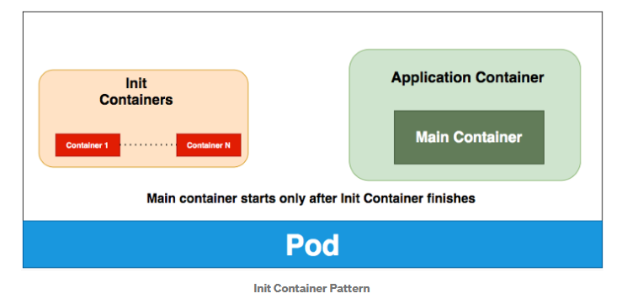
..

Slide 4
.
Init containers are exactly like regular containers, except:
Init containers always run to completion.
Each init container must complete successfully before the next one starts.
To specify an init container for a Pod, add the initContainers field into the Pod specification, as an array of container items
If you specify multiple init containers for a Pod, kubelet runs each init container sequentially. Each init container must succeed before the next can run

Slide 5
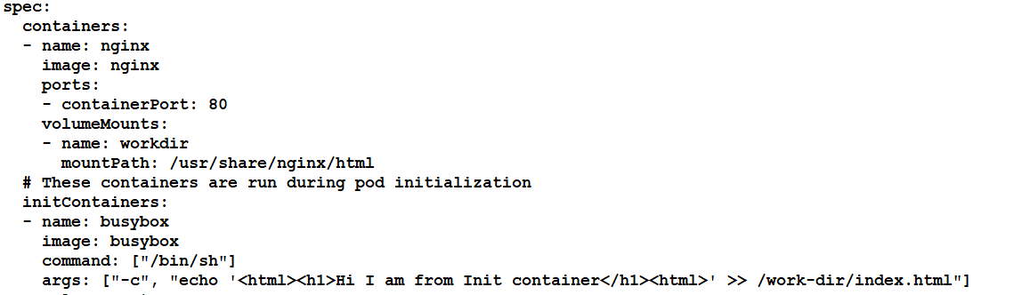
yaml

Slide 6
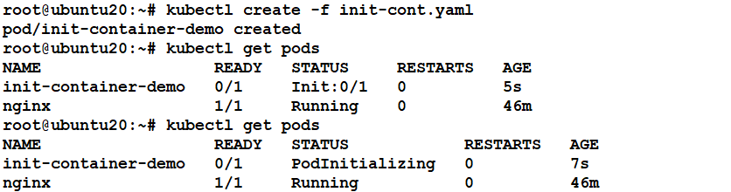

Slide 7
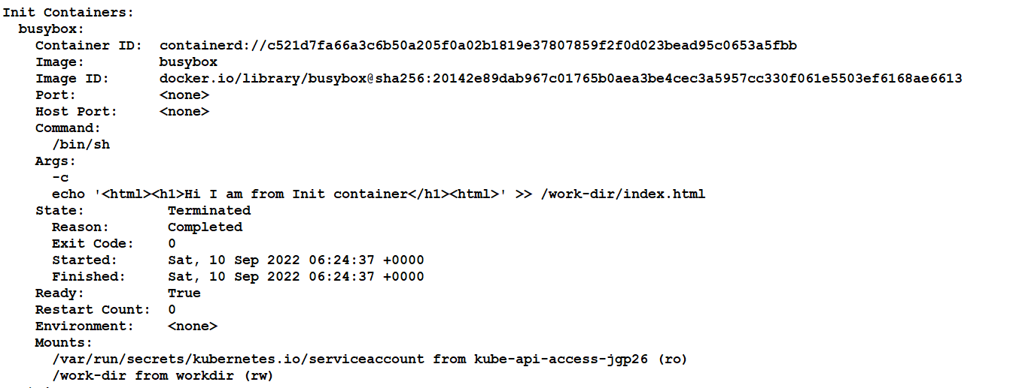
Kubectl describe pods <pod name>

